Slide 1


INSTAGRAM USER ANALYTICS

Slide 2
Data Analytics Trainee
TASK 2 : INSTAGRAM USER ANALYSIS
NAME : BHAGYASHREE PARATE
EMAIL : bhagyashreeparate307@gmail.com
Analysis done on the following points:-
Part (A). Marketing :-
Rewarding Most Loyal Users
Remind Inactive Users to Start Posting
Declaring the contest winner
Hashtag Researching
Launch AD Campaign
Part (B). Investor Metrics :-
1. User Engagement
2. Bots and Fake Accounts

Slide 3
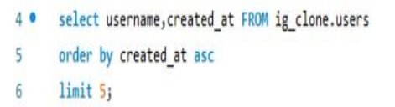
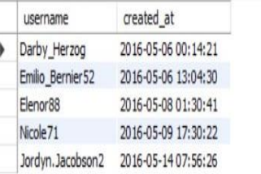
SOFTWARE USED : MySQL Workbench 8.0 CE
Marketing Analysis :
Loyal User Reward:
The marketing team wants to reward the most loyal users, i.e., those who have been using the platform for the longest time. The following query selects the top 5 users who have been on the platform for the longest time:
Output
Quary :

Slide 4
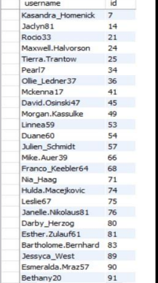
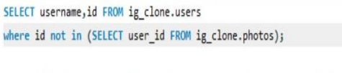
Inactive User Engagement:
The team wants to encourage inactive users to start posting by sending them promotional emails. The following query selects all users who have never posted a single photo on Instagram:
Query: Output:

Slide 5
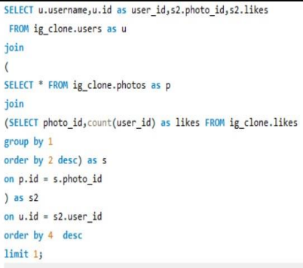

Contest Winner Declaration:
The team has organized a contest where the user with the most likes on a single photo wins. The following query selects the user with the most likes on a single photo:
Query : Output :

Slide 6
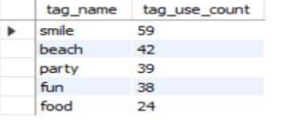
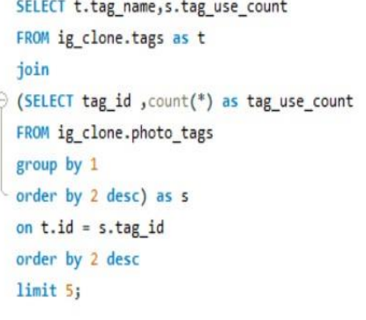
Hashtag Research:
A partner brand wants to know the most popular hashtags to use in their posts to reach the most people. The following query selects the top 5 most popular hashtags on Instagram:
Query : Output :

Slide 7
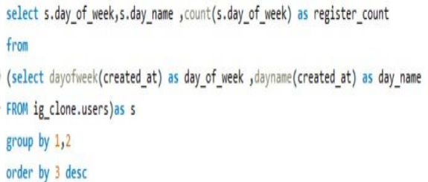
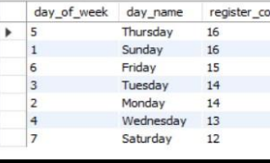
Ad Campaign Launch:
The team wants to know the day of the week when most users register on Instagram. The following query selects the day of the week when most users register on Instagram:
;
Query : Output :

Slide 8
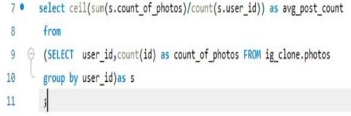



II Investor Metrics
User Engagement: Investors want to know if users are still active and posting on Instagram or if they are making fewer posts. The following queries calculate the average number of posts per user on Instagram:
SELECT COUNT(*) AS total_users, COUNT(DISTINCT user_id) AS active_users
FROM posts;
SELECT COUNT(*) AS total_photos, COUNT(DISTINCT photo_id) AS total_unique_photos
FROM photos;
Query : Output :

Slide 9
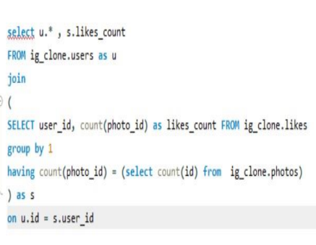
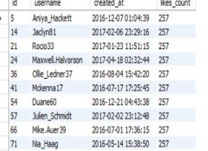
Bots & Fake Accounts:
Investors want to know if the platform is crowded with fake and dummy accounts. The following query selects users who have liked every single photo on the site. This is not typically possible for a normal user, so it is likely that these
Query :
Output :

Slide 10
Explanation:
Project Description: A brief overview of the project, explaining its purpose and the approach we will take to handle the tasks and derive insights.
Approach: Describe our approach towards the project and how we executed it. Explain the steps we took to analyze the data and find the answers to the questions.
Tech-Stack Used: Specify the software and versions we used for the project (e.g., MySQL Workbench, SQL Server Management Studio) and briefly explain why we chose them for the project.
Insights: Summarize the insights and knowledge we gained while working on the project. Explain the inferences we made from the data, highlighting any significant findings or patterns. Keep the insights concise and relevant to the project.
Result: State the achievements we accomplished through the project and how it has benefited us or provided valuable information. Share our thoughts on the impact of the analysis and the insights derived from it.

Slide 11
Thank you

